Slide 1

GESTURE BASED TV REMOTE CONTROL
USING ULTRASONIC SENSOR AND IR TRANSMITTER

Slide 2
TEAM MATES
R.SHAM HIRUTHIK
P.K.THAMBI DURAI
G.V.SARAN

Slide 3
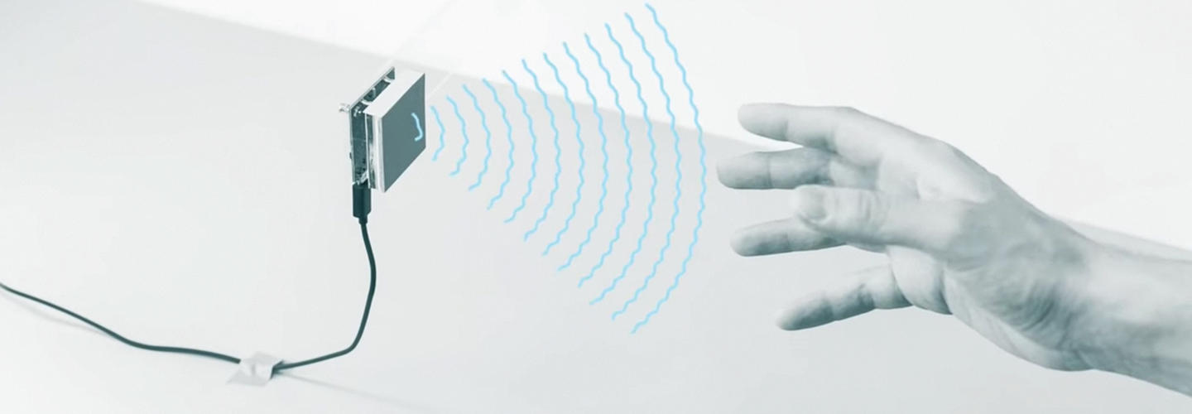
INTRODUCTION
It is a project on GESTURE BASED TV REMOTE CONTROL using Ultrasonic sensor and IR transmitter interfacing with Arduino UNO. For television we are using HEX code but here we are using RGB LED where the all commands will be shown a serial monitor and with different colours on RGB. We can interface with our TV Where swiping over within the specified range in code shows different colours on RGB and different operations if you are using the TV.

Slide 4
HARDWARE REQUIRED:
SOFTWARE REQUIRED:
Arduino uno with USB cable – 1
Ultrasonic sensor HC SR04 – 1
Breadboard 400 point – 1
RGB Led – 1
IR led – 1
Single stand wire 2m - 1
Resistor 220 ohm – 3
Jumper wires male to female– 40 Pieces
Jumper wires male to male– 40 Pieces
Arduino IDE 1.8.5

Slide 5
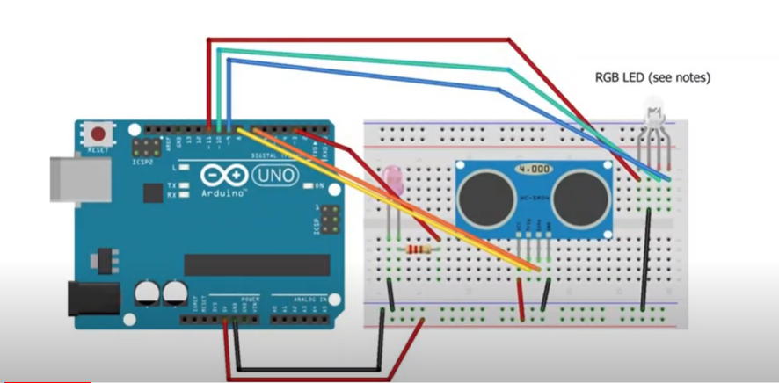
CIRCUIT DESCRIPTION
Connect the IR LED to pin 3 via an appropriate resistor, and then connect the cathode to GND.
Connect the ultrasonic sensor to 5v and GND where the pins specify. Connect the trigger pin to pin 8 and the echo pin to 7. You can configure these pins in the sketch.
Connect the RGB LED to GND and pins 11 (red), 10 (green), 9 (blue). These pins are also configurable.

Slide 6
WORKING
POWER: Swiping over the sensor within 3 inches will cause the LED to flash purple. This is the confirmation that a 'turn on / off' signal is ready to be sent. To prevent it accidentally turning the TV off I have made the sketch wait for a second swipe within 5 seconds of the first to confirm. At this point, the signal is sent to the TV to turn on or off.
CHANNEL: Swiping within 10 inches of the sensor (but not within 3) will cause the channel to change down. Swiping between 10 and 20 inches will cause the channel to change up.
VOLUME: Holding your hand within 10 inches of the sensor (but not within 3) will cause the volume to change down. Holding between 10 and 20 inches will cause the volume to change up. The volume will continue to change (up or down) until your hand is removed.
APPLICATION
Gesture recognition is used more or less exactly as you would imagine in smart TVs. It allows users to change the channel, adjust volume and brightness, control the picture quality and even view multiple screens and access social networking sites.

Slide 7
PROS
CONS:
Makes interacting with TVs easier.
Reduces the need for remote controls.
Provide a richer experience to users.
Provide easy integrations with other technologies such as face recognition and voice recognition
The software maybe inaccurate at sometimes.
Objects in the background may disrupt the input.
The HC-SR04 sensor is not the most accurate ultrasonic sensor on the market.
One of the major issues plaguing the Global Gesture Recognition for Smart TV Market is the lack of standardization in the actual gestures used to control TVs.

Slide 8
DEVELOPMENT & RESOLVE
Using High accuracy Ultrasonic sensor.
We can increase the accuracy of the sensor by giving an Visual inputs like camera recognition of Gestures.
Currently, the Global Gesture Recognition Market for Smart TV has several leading vendors, resulting from the commercialization of gesture-enabled consumer electronics. Many pure-play companies are being acquired by large corporations for their technological expertise in gesture recognition. This will lead to major development GESTURE BASED TECHNOLOGY.
CONCLUSION:
So by here we’ve made a GESTURE BASED TV REMOTE CONTROL Using Ultrasonic Sensor and IR sensor.

